Slide 1

Report For Dec-2022 Mass Production Inspection

Slide 2
#1
Problems Description
Issue Description
When | 2022.10.01
Who | ALT customer
Where | Korean
What | ALT customer request to analyze 5 RMA units, no boot issue
Why | The root cause is P3V3 power was shorted with GND
How | Product can not boot
How many | Total 5pcs and detail as table below:
No# | NG1 sample | NG2 sample | NG3 sample | NG4 sample | NG5 sample
MAC | 38D57AD8588B | 38D57ADA242B | 4CD577FFEFFF | 38D57ADA046F | 38D57AD810F4
SN | 2149688001202201093490 | 2149688001202201206149 | 2149688001202201069841 | 2149688001202201204082 | 2149688001202201072761
Production Date | 2022.02.10 | 2022.04.22 | 2022.01.07 | 2022.04.02 | 2022.01.22
Issue | No boot | No boot | No boot | No boot | No boot

Slide 3
#2
RMA Analysis Plan
Step | Items | Contents | Owner | Status | Result
1 | Visual inspection | Inspect appearance of housing | PD: Van Anh | Done | No damaged or any abnormal
2 | Baking | Baking 24h at 45⁰C | PD: Van Anh | Done | N/A
3 | Re-test OBA function | Re-test function at OBA station | OBA: Tu | Done | 5/5 units can not boot
4 | Open housing & VI PCBA | Open housing and inspect PCBA | PE: Nam | Done | 4 units aren’t abnormal. 1 unit (NG5 sample) was burnt at R823, R824,R825, R826 locations. Therefore, can not further repair and analyze.
5 | Take X-ray | Take X-ray focus on: U1, U602, U801, U1101, U1001 locations | ME: Hugo | Done | PASS
6 | Failure Analysis of NG1~NG4 samples | Retest FATP | PE: Nam | Done | 4/4pcs no boot from UK station
 |  | Double check history record production data | PE: Nam | Done | No found abnormal
 |  | Measure impedance, voltage all power supplies | PE: Nam | Done | - For NG1+NG2: P3V3 (3.3V) and ETH_DVDD10 (1V) power supplies was shorted with GND. - NG3+NG4: P3V3 (3.3V) power supply was shorted with GND.
 |  | - For NG1+NG2 sample: Remove and measure impedance + VF of U801 location then compare with OK sample. - For NG3+NG4 sample: Remove & measure impedance + VF of U1 then compare with OK sample. | PE: Nam | Done | - For NG1+NG2: pins of U801 component relate to ETH_DVDD10 and P3V3 power supplies was shorted. - For NG3+NG4: all pins of U1 component relate to P3V3 supply was shorted.
 |  | - For NG1+NG2 sample: Changed new U801 (RTL8211F) then check boot up status. - For NG3+NG4 sample: Changed new U1 (S905X2 ) then check boot up status. | PE: Nam | Done | 4 units boot up normal.
7 | FATP | Re-test 4 RMA units at all test stations after changed new U801 and U1 material. | PD: Van Anh | Done | 4 units passed all test station.
8 | OBA test | Test function at OBA station. | OBA: Tu | Done | 4 units passed functional test at OBA station.

Slide 4

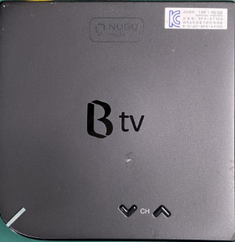


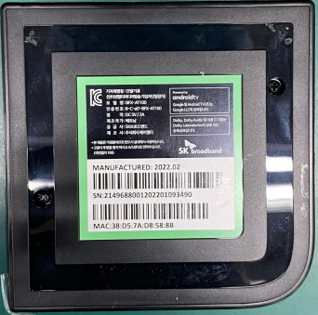
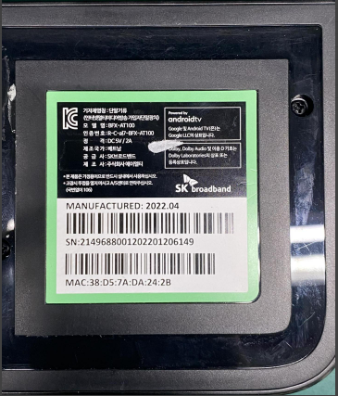
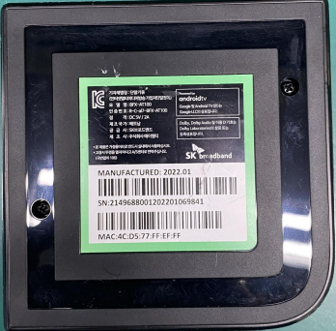
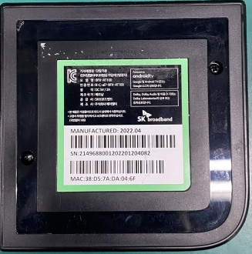
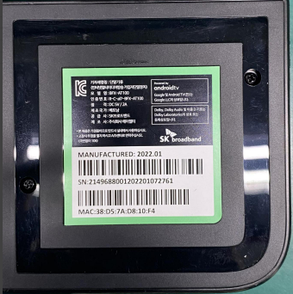
#3
Visual Inspection
Check appearance of housing
Visual Inspection Outside Housing
 | NG1 | NG2 | NG3 | NG4 | NG5
Top side
Bot side
Result: No found any damaged or abnormal.

Slide 5
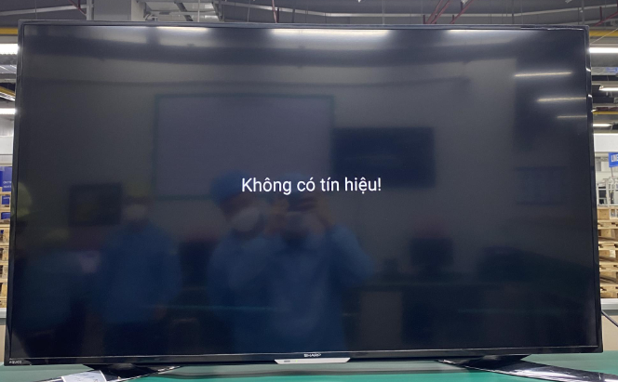
#4
Re-test OBA Function
Baking 5pcs RMA 24h at 45⁰C.
Re-test function at OBA station.
Can not boot up
Result:
Baking 5pcs RMA 24h in 45⁰ (Done).
5pcs can not boot up when re-testing at OBA station.

Slide 6
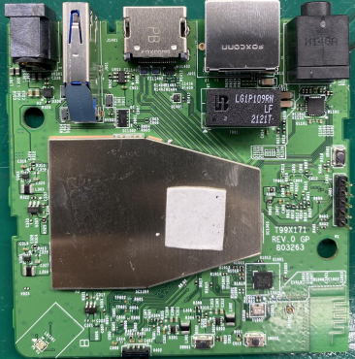
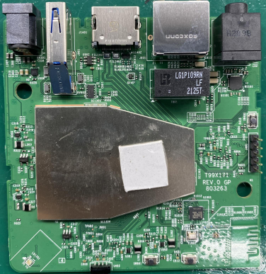
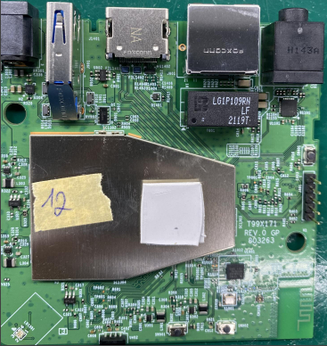
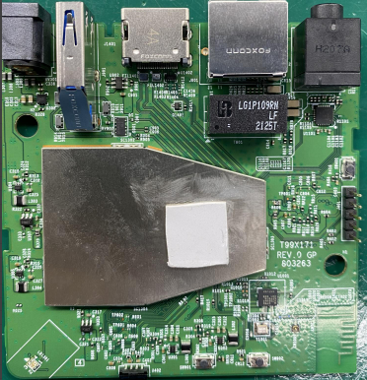
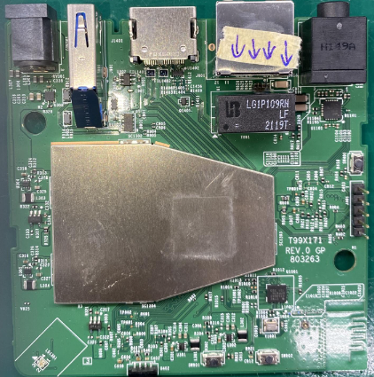
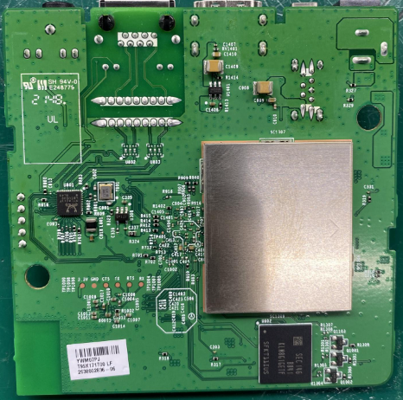
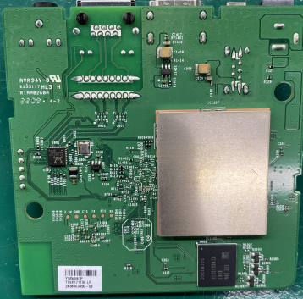
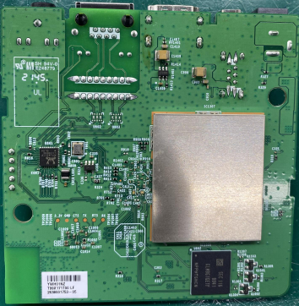
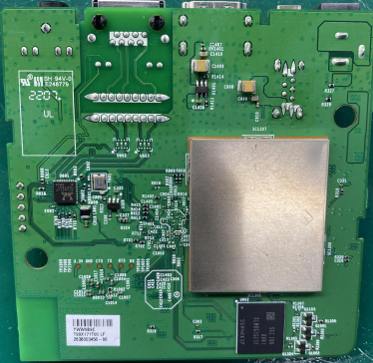
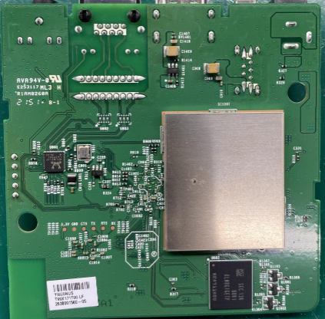
#5
PCBA Visual Inspection
Open housing and inspect PCBA, detail as table below:
NG sample | NG1 | NG2 | NG3 | NG4 | NG5
Top side
Bot side
VI Result | Pass | Pass | Pass | Pass | Burn at R823, R824, R825, R826 locations

Slide 7
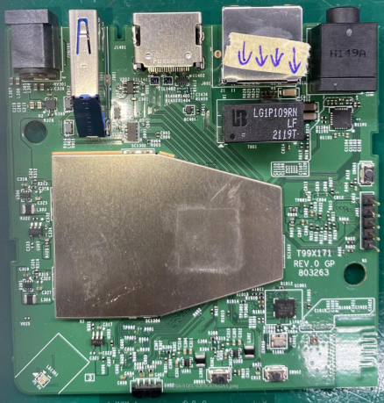
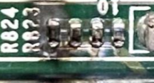
#5
PCBA Visual Inspection
Due to NG5 sample was burnt at R823,R824, R825, R826 locations ➔ Therefore, can not further repair and analyze.
Burnt locations
Result:
NG1 to NG4 samples is normal.
NG5 sample was burnt at 4 location, so can not further analyze..

Slide 8
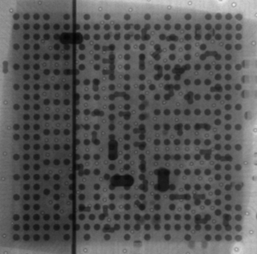
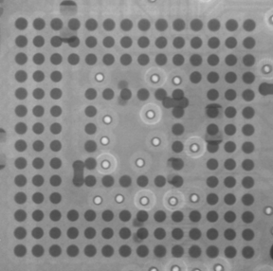
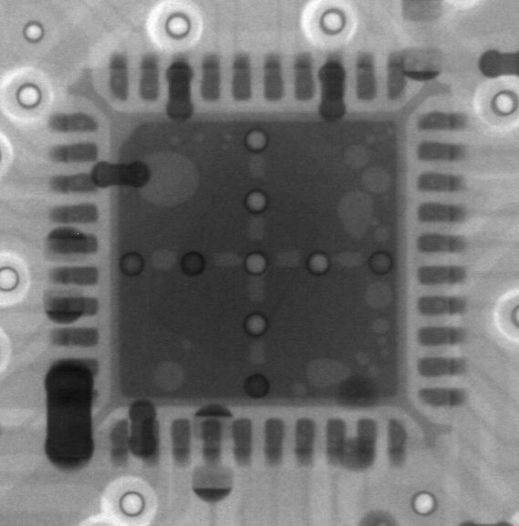
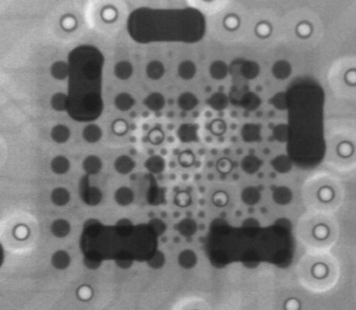
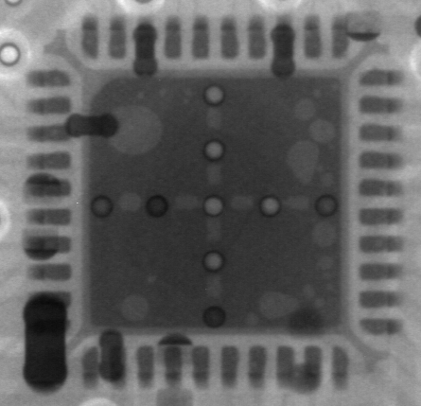
#6
Take X-ray
Take X-ray 5 locations : U1, U602, U1101, U1001, U801 of 5 NG samples, detail images as below:
NG# | Image
NG1
NG2
NG3
NG4
NG5
U1
U602
U1101
U1001
U801
U1
U602
U1101
U1001
U801
U1
U602
U1101
U1001
U801
U1
U602
U1101
U1001
U801
U1
U602
U1101
U1001
U801
Result: No found any abnormality.

Slide 9
#7
Failure Analysis
7.1 Re-test 5 NG samples at all test stations follow normal process.
UK
FT
FT1
RC
RC1
RC2
I
1.Auto copy flash by Burning Tool
(2’80 s)
5 NG samples can not boot from first station.
➔ Test station can cover 100% no boot issue
Result:
5 NG sample can’t boot at test station.
Test station can cover 100% this issue.

